Slide 1
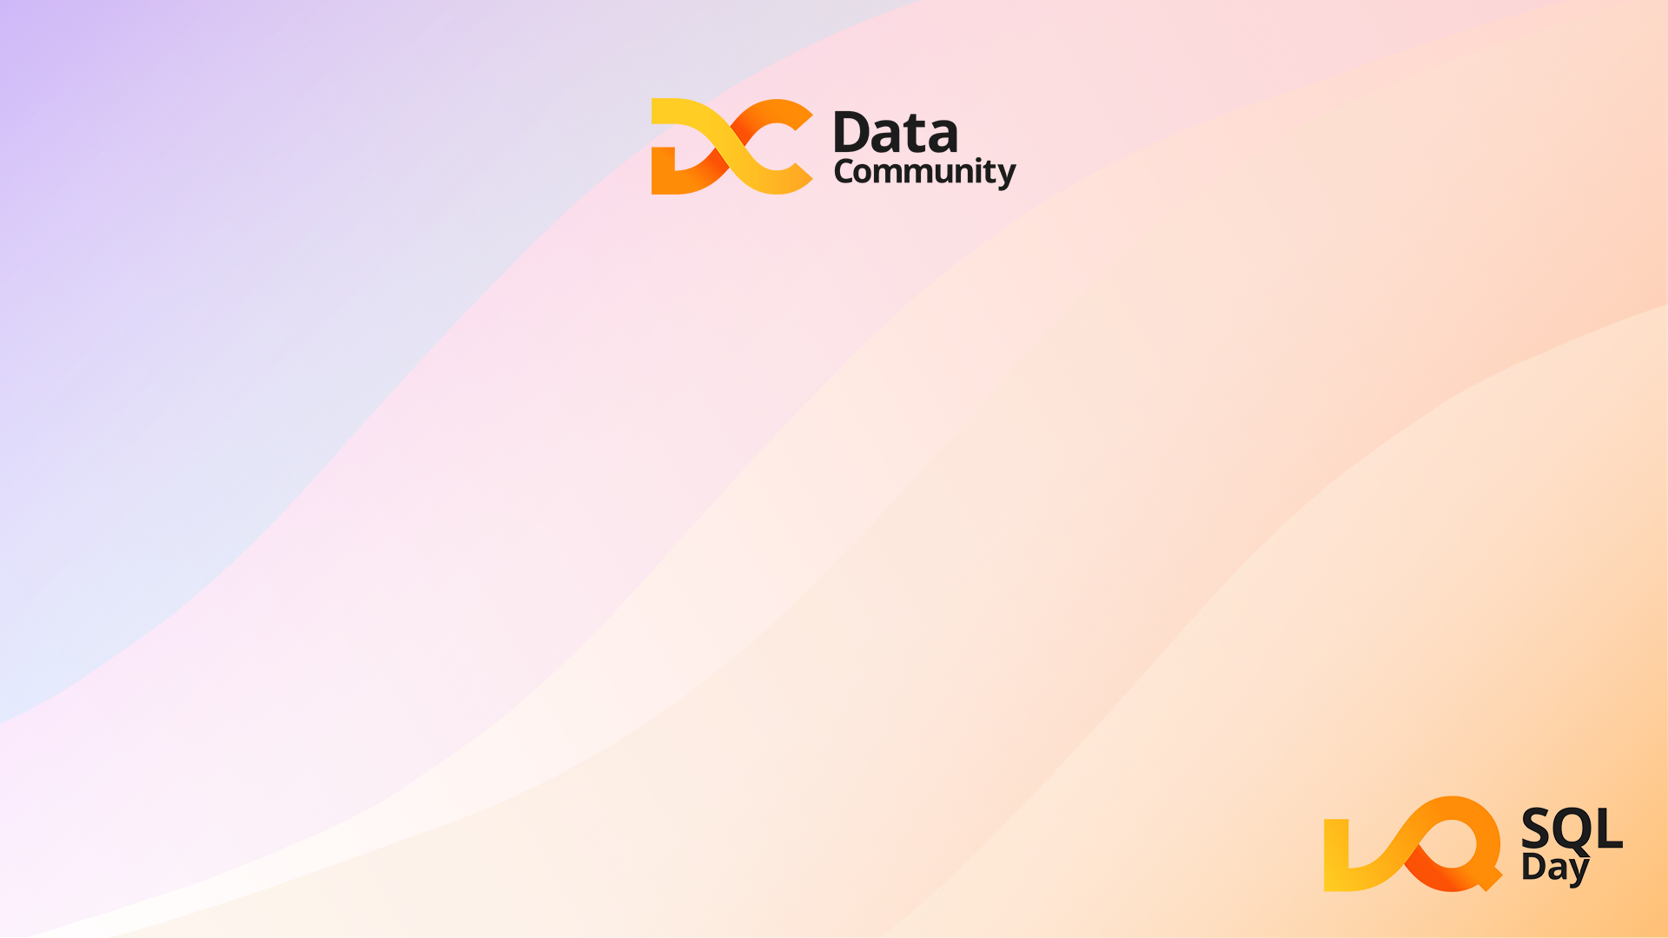
Protecting Your Data With SQL Ledger
Dennes Torres

Slide 2

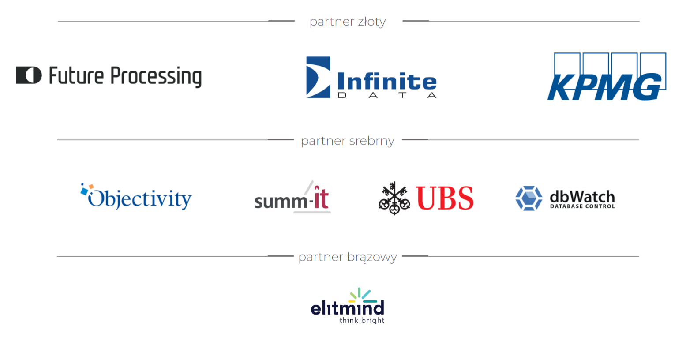

Slide 3



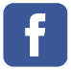




Dennes Torres Data Platform MVP
Dtower Software
https://dtowersoftware.com
Trainer
MCT, Azure Solutions Architect, Azure Data Engineer and Azure DevOps Engineer
Malta Data Platform UG Leader
Malta
MMDPUG
https://www.facebook.com/MMDPUG
http://dennestorres.com
https://msteams.link/3BGW
Dennes.Torres
@Dennes
https://br.linkedin.com/in/dennestorres
dennes@DTowerSoftware.com
http://youtube.com/c/dennestorres

Slide 4

AGENDA
What’s Azure SQL Ledger
How Azure SQL Ledger Works
Types of Tables
Demo
External Storage
Provisioning Azure SQL Ledger Database
Azure SQL Ledger System Tables

Slide 5
What’s Azure SQL Ledger

Slide 6
Why
Some solutions require a higher level of data integrity
The Blockchain decentralization can be an overkill
Example: Igaming players Wallet, Parts tracking
Some companies were using third part solutions as workarounds
You need to prove your data has not being tampered with

Slide 7
What
Each Transaction is recorded as a history
Digest blocks are created for the transactions
Digest blocks are saved externally to the database
The digests can be used for integrity verification

Slide 8
How Azure SQL Ledger Works

Slide 9
How
The transactions are recorded in a system table
Digest blocks are created for the transactions
Digest blocks are asynchronously transferred to external storage
Verifications can be triggered regularly

Slide 10
Provisioning Azure SQL Ledger Database

Slide 11
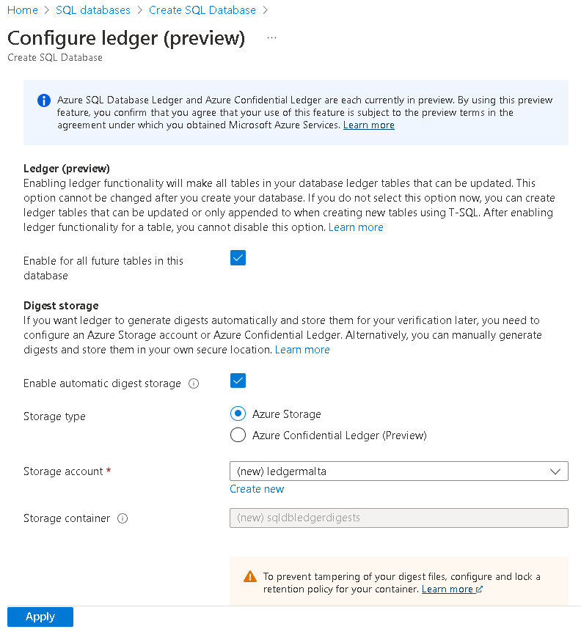
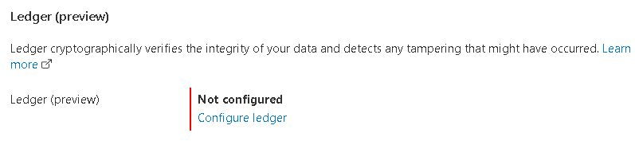
Provisioning Azure SQL Ledger Database

Slide 12
Types of Tables

Slide 13
Updatable Ledger Table
Keeps a history of all operations
Based on Temporal Tables
A View retrieve information about the operations

Slide 14
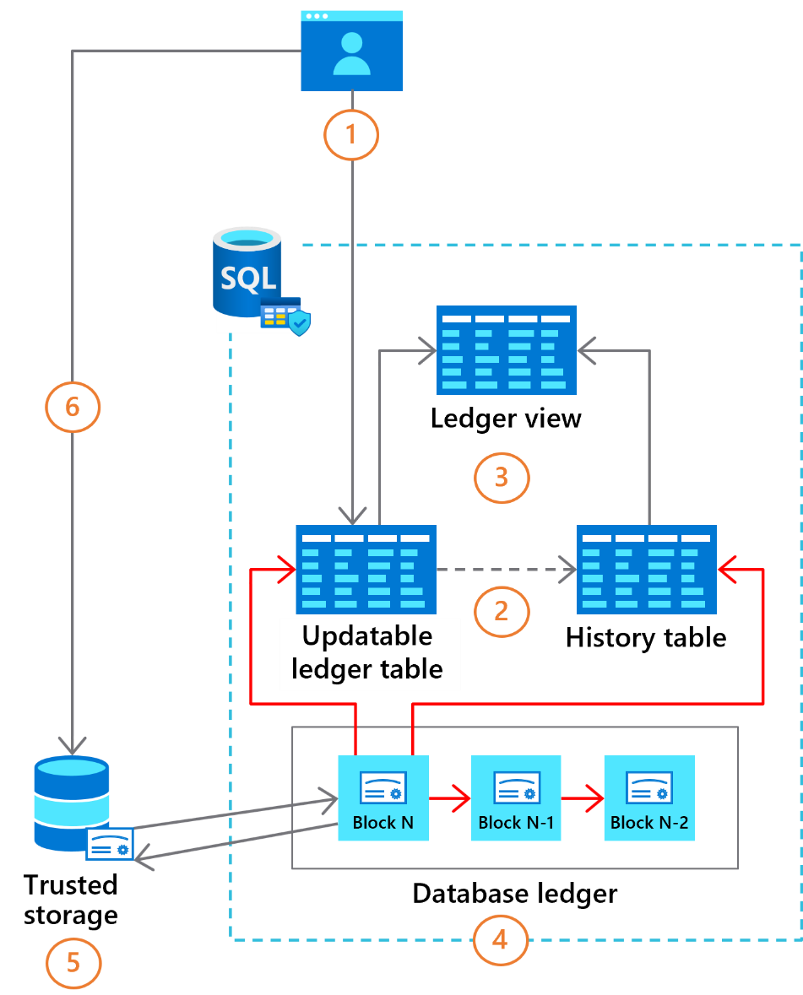
Updatable Ledger Table

Slide 15
Append-Only Ledger table
No Update is accepted
No need for a history table
The view is less useful

Slide 16
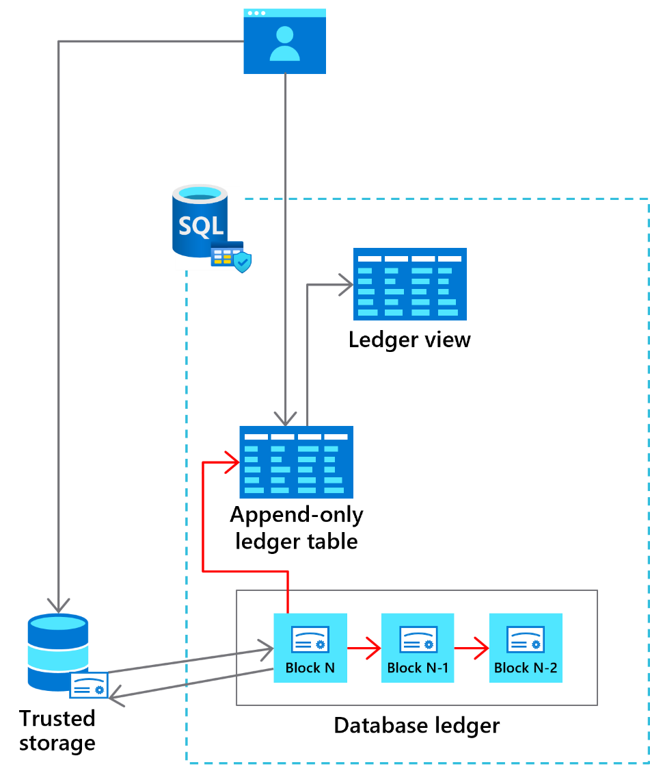
Append-Only Ledger Table

Slide 17
Azure SQL Ledger System Tables

Slide 18
System Tables
sys.database_ledger_transactions
sys.database_ledger_blocks
sys.ledger_table_history
sys.ledger_column_history
sys.database_ledger_digest_locations

Slide 19
Demos

Slide 20
External Storage

Slide 21
External Storage
Azure Storage Account
Azure Confidential Ledger

Slide 22
Azure Storage Account
Hierarchical Namespace is disabled
It uses Append Blob
Content Type Application/Octet-Stream
Recommended: Apply a immutability property

Slide 23
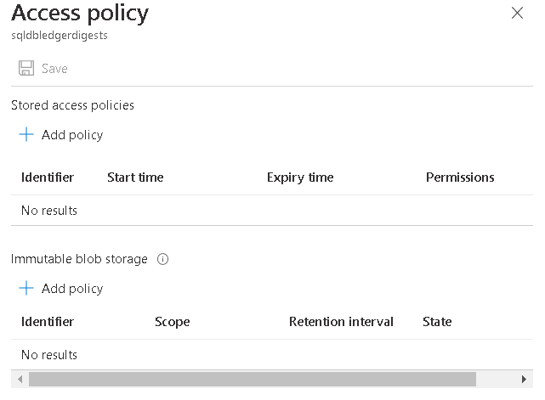
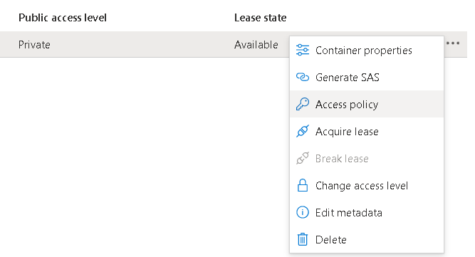
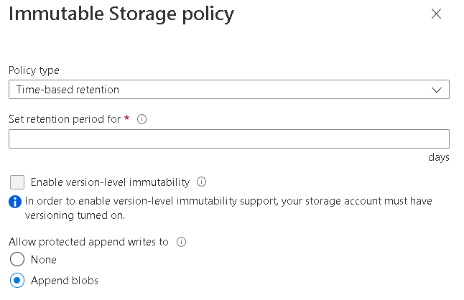
Immutability Property

Slide 24
Azure Confidential Ledger
Azure Service to Store immutable data
Uses multiple blockchain nodes on the backend
It’s still in preview (such as SQL Ledger)

Slide 25
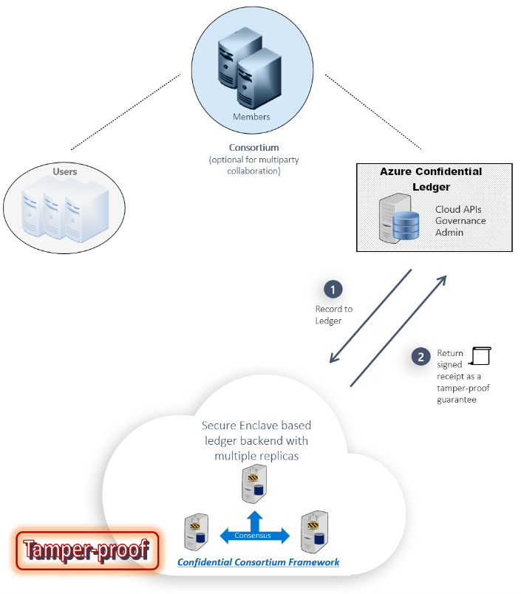
Azure Confidential Ledger

Slide 26
References
SQL Ledger Documentation
SQL Ledger Articles
SQL Ledger White Paper
https://azure.microsoft.com/en-us/resources/-sql-ledger-cryptographically-verifiable-data-in-azure-sql-database-/
https://docs.microsoft.com/en-us/azure/azure-sql/database/ledger-overview
https://sqlservergeeks.com/azure-sql-database-ledger-part-1-by-jason-m-anderson/
https://sqlservergeeks.com/azure-sql-database-ledger-part-2-by-jason-m-anderson/
Azure Confidential Ledger Documentation
https://docs.microsoft.com/en-us/azure/confidential-ledger/

Slide 27
Dennes Torres Data Platform MVP
Dtower Software
https://dtowersoftware.com
Trainer
MCT, Azure Solutions Architect, Azure Data Engineer and Azure DevOps Engineer
Malta Data Platform UG Leader
Malta
MMDPUG
https://www.facebook.com/MMDPUG
http://dennestorres.com
https://msteams.link/3BGW
Dennes.Torres
@Dennes
https://br.linkedin.com/in/dennestorres
dennes@DTowerSoftware.com
http://youtube.com/c/dennestorres

